Slide 1
3
Luís Ferreira
lufer@ipca.pt
June 2, 2025

Slide 2
Python Programming
Basic operations
Data types
Execution control statements
List comprehensions, iterators, etc.
Functions

Slide 3
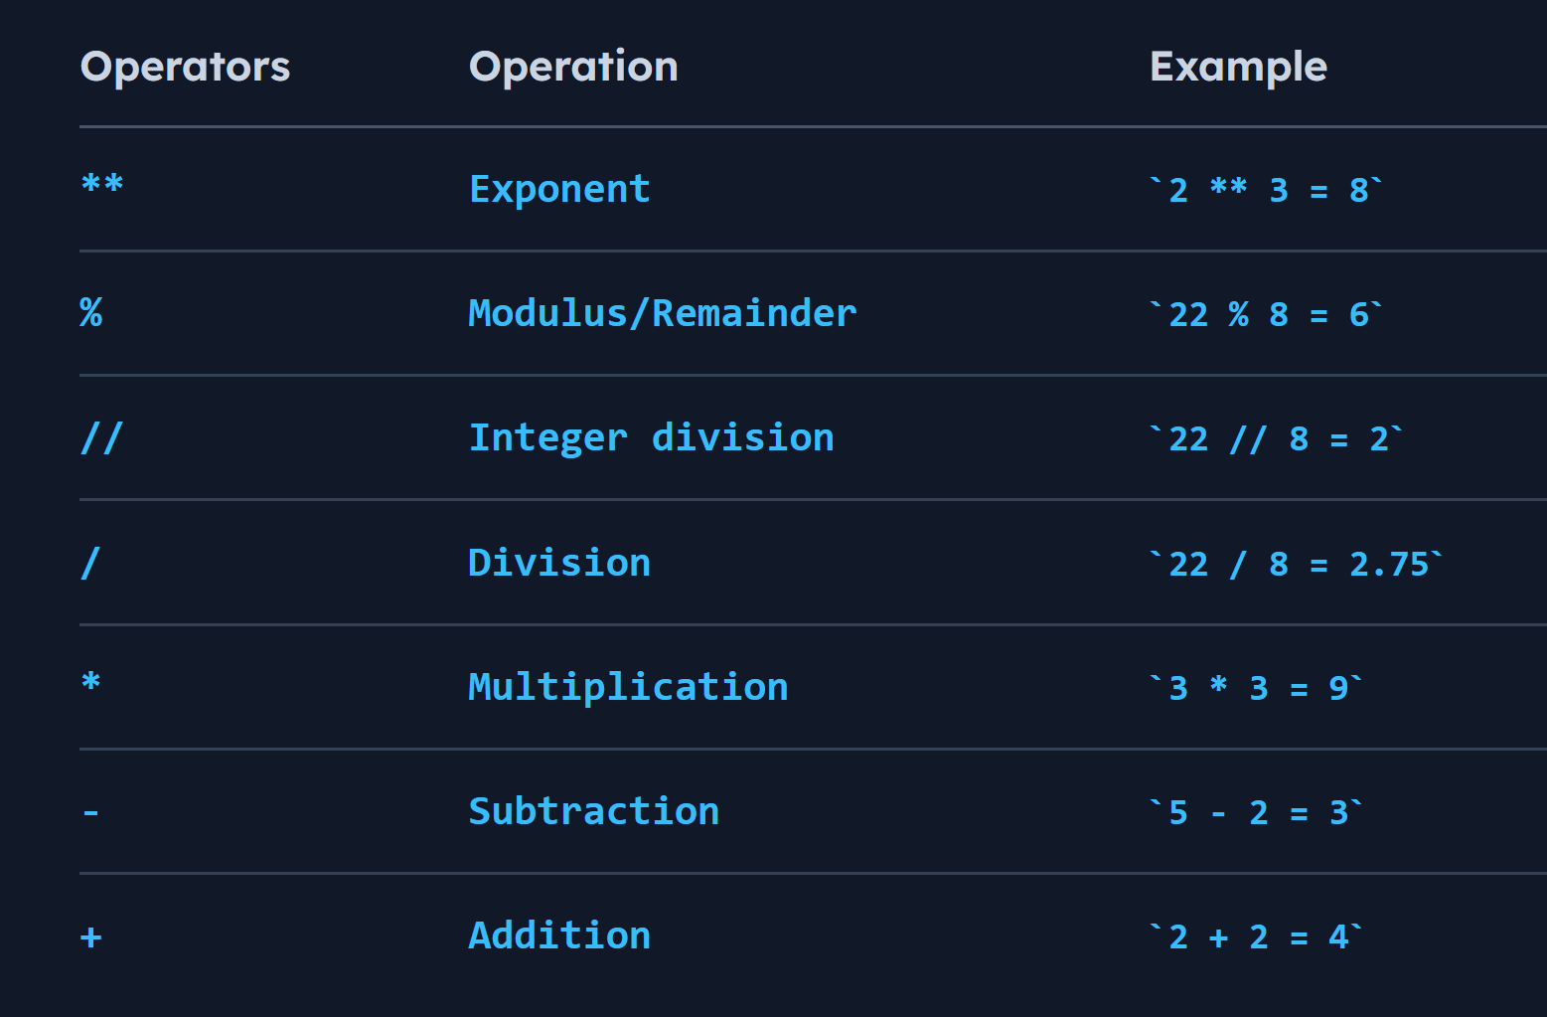
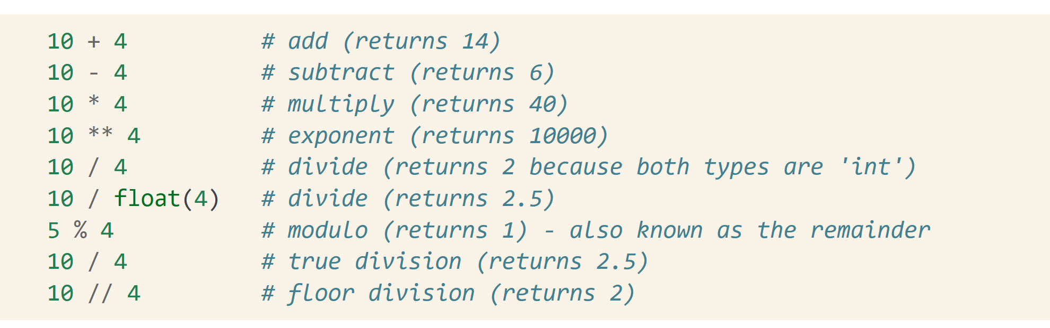
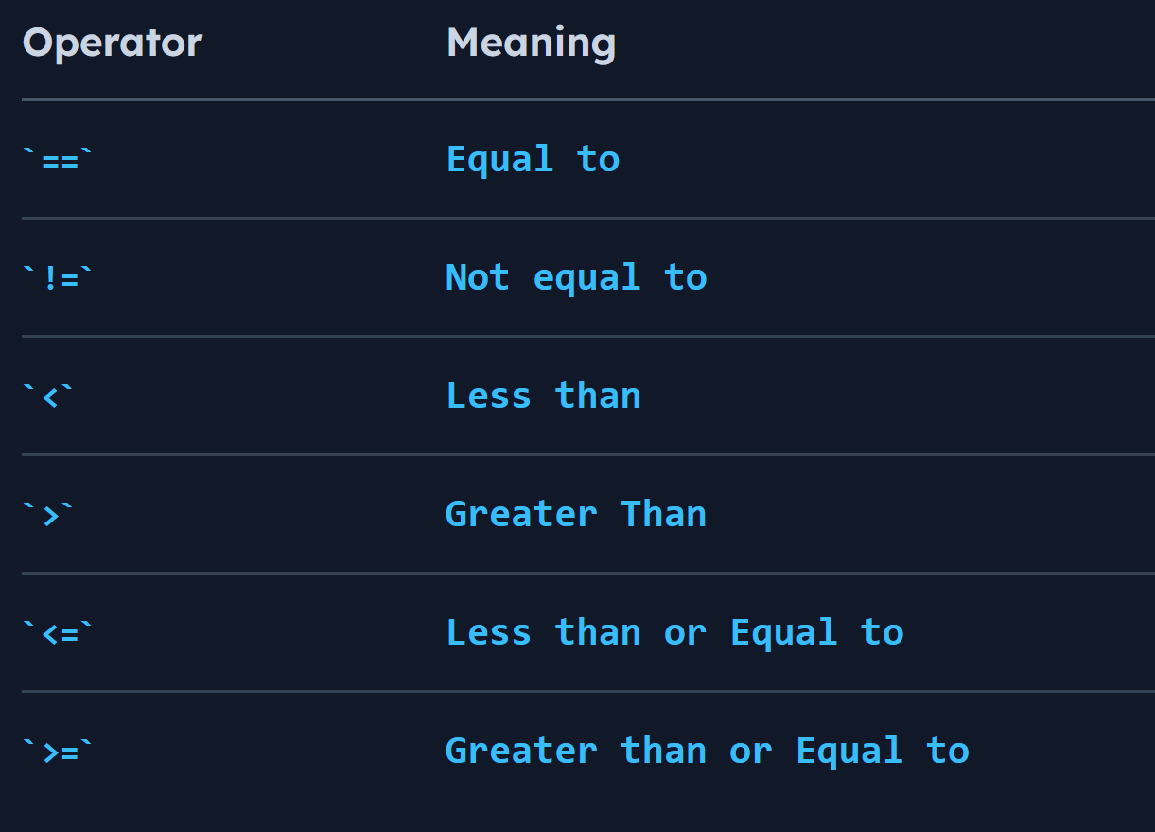
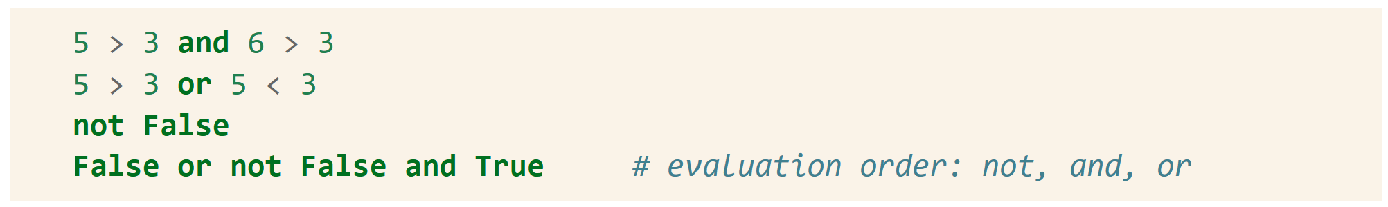
Basic Operations
Numbers
Logic
[3]

Slide 4
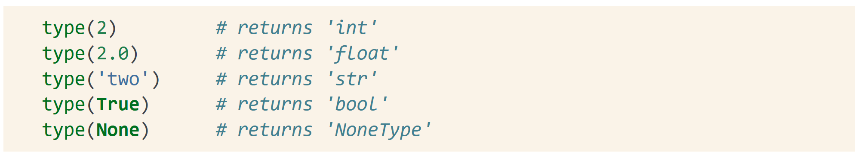
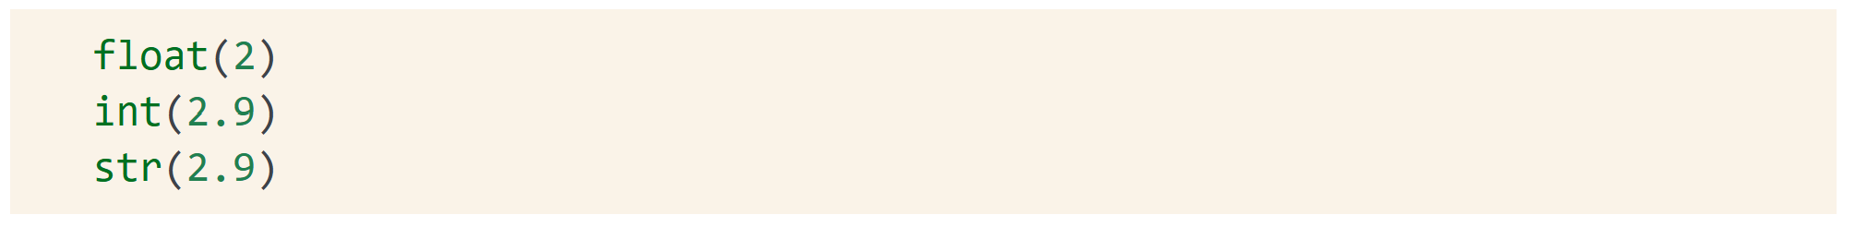
Data Types
Type of an object
Check the type
Type conversion

Slide 5
Data Types
Lists
lists are ordered, iterable, mutable (adding or removing objects changes the list size), can contain multiple data types.
insert() simpsons.insert(1,”maggy”)
remove() simpsons.remove(“homer”)
append() simpsons.append('lisa')
extend() simpsons.extend(['itchy', 'scratchy'])
indexing simpsons[1]
sort() simpsons.sort()
(many others)

Slide 6
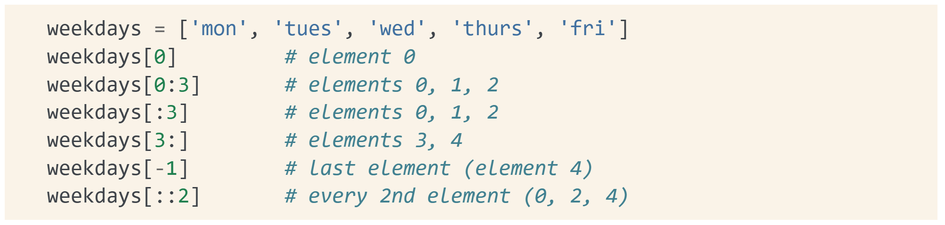
Data Types
Lists
lists are ordered, iterable, mutable (adding or removing objects changes the list size), can contain multiple data types.
Slicing | Selection

Slide 7
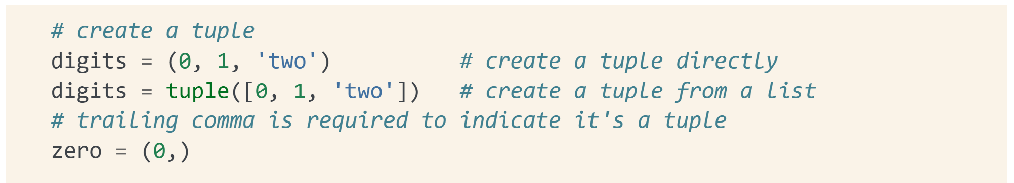
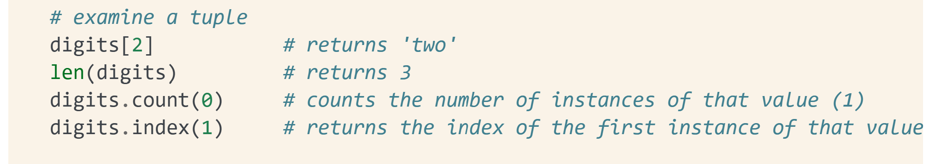
Data Types
Tuples
Like lists, but their size cannot change: ordered, iterable, immutable, can contain multiple data types.

Slide 8
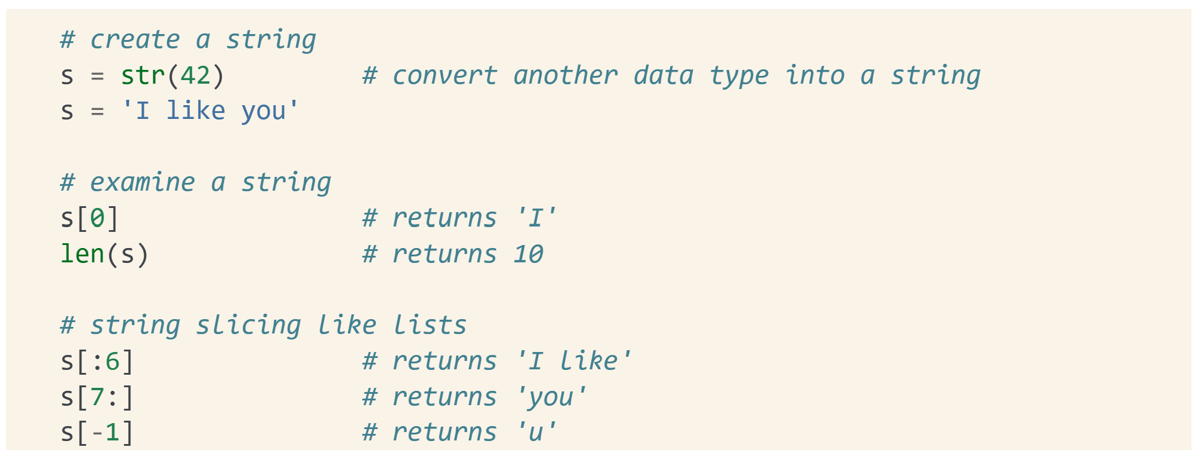
Data Types
Strings
A sequence of characters, they are iterable, immutable.
lower() s.lower()
upper() s.upperr()
isdigit() s.isdigit()
find() s.find(‘ka’)
replace() s.replace(‘k’,’t’)
split s.split(‘,’)
concatenate s + p
strip s.strip()
slicing
(many others)

Slide 9
Data Types
Dictionaries
structures which can contain multiple data types, and is ordered with key-value pairs: for each (unique) key, the dictionary outputs one value. Keys can be strings, numbers, or tuples, while the corresponding values can be any Python object. Dictionaries are: unordered, iterable, mutable.
len
keys()
values(()
Items()
(many others)
simpsons_dict = {
'Homer': 'father’,
'Marge': 'mother’,
'Bart': 'son’,
'Lisa': 'daughter’,
'Maggie': 'daughter’
}
See jupyter notebook

Slide 10
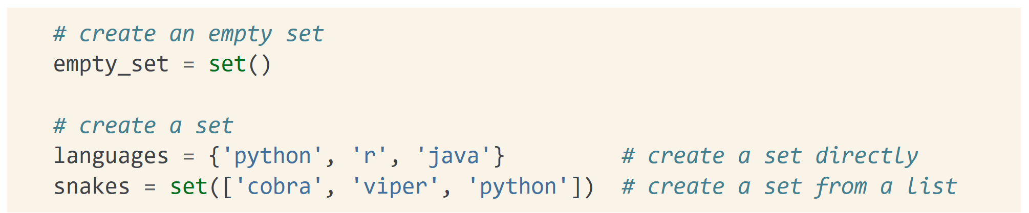
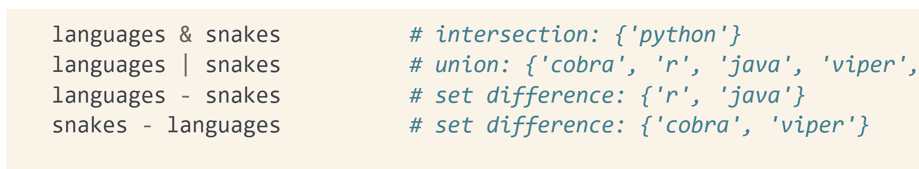
Data Types
Sets
Like dictionaries, but with unique keys only (no corresponding values). They are: unordered, iterable, mutable, can contain multiple data types made up of unique elements (strings, numbers, or tuples).

Slide 11
Execution control statements
Conditional
Loops
Iterators

Slide 12
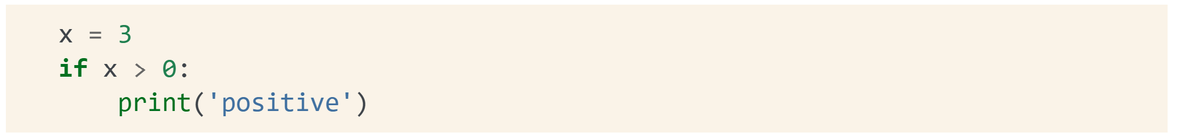
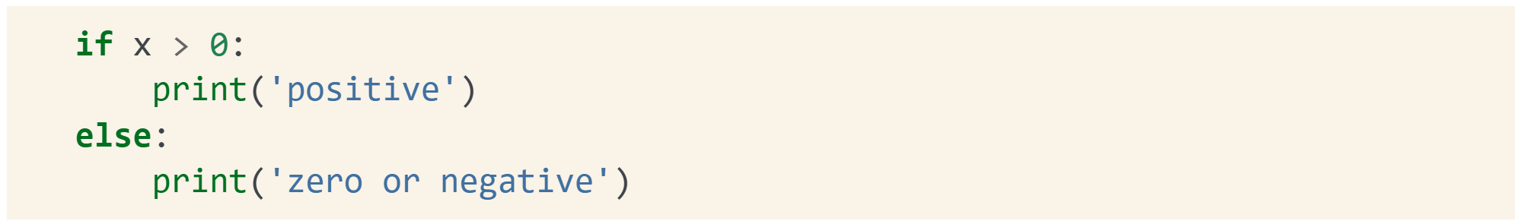
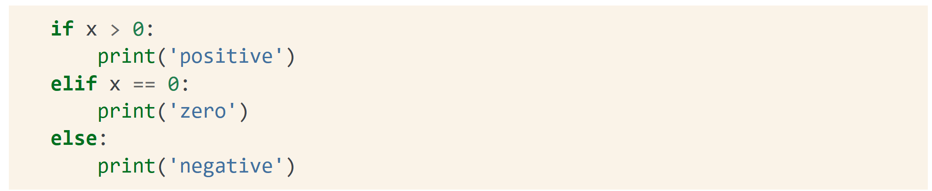
Conditional Execution
if..: | if..else…: | if..elif…else..:

Slide 13
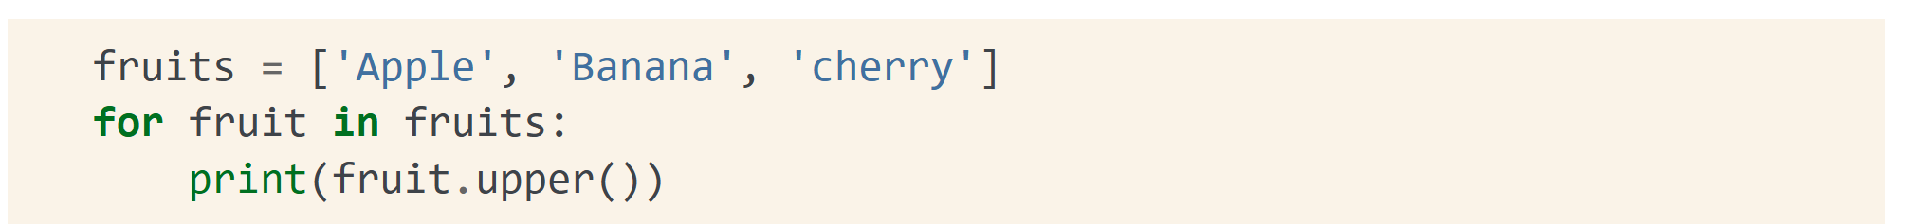
Loop Execution
for...in..:
while cond:
i=3
while i>0:
print(i)
i = i – 1

Slide 14
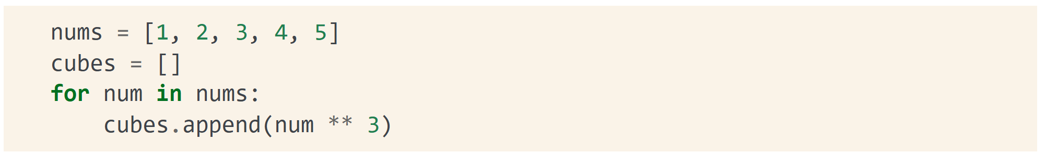
Iterators and comprehensions
Iterate over a list and apply some operation
Create a dictionary from a a list

Slide 15
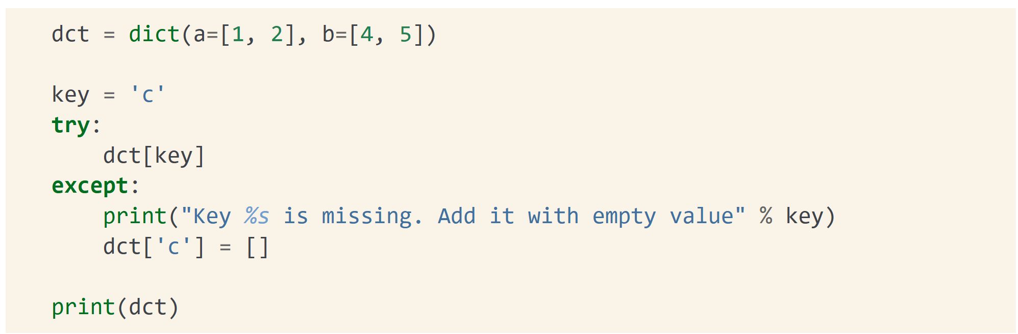
Exception Handling
Avoid running problems
If the dictionary key is not there, insert it!

Slide 16
References
[1] - Statistics and Machine Learning in Python, Release 0.8, Edouard Duchesnay, Tommy Löfstedt, Younes Feki
[2] - Documenting Python Code: A Complete Guide - https://realpython.com/documenting-python-code/
[3] – Python Cheat Sheet, Mosh Hamedani
[4] - Automate the Boring Stuff with Python, Al Sweigart, https://automatetheboringstuff.com/

